Slide 1
Rectifiers, Clippers and Clampers
Engr. Muhammad Waqas

Slide 2
Application of Diodes
Rectifiers
Transistors
Clipper and Clampers

Slide 3
introduction
A rectifier is an electrical device that converts alternating current (AC), which periodically reverses direction, to direct current (DC), which is in only one direction, a process known as rectification.

Slide 4

Types of Rectifiers
Half wave Rectifier
Full wave Rectifier
Bridge Rectifier

Slide 5
Half wave rectifier
In half wave rectification, either the positive or negative half of the AC wave is passed, while the other half is blocked.
Because only one half of the input waveform reaches the output, it is very inefficient if used for power transfer.

Slide 6
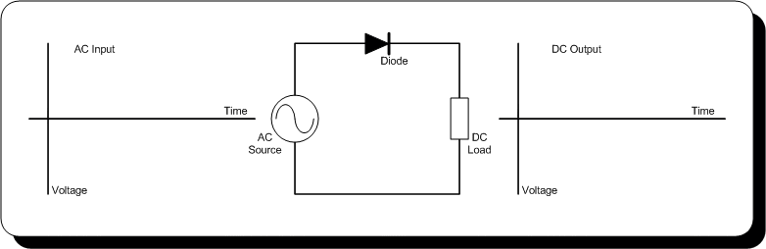
Half wave rectifier working animation

Slide 7
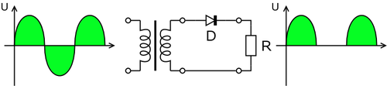
Half wave rectification

Slide 8


Output dc voltage calculation
The output DC voltage of a half wave rectifier can be calculated with the following two ideal equations

Slide 9
full wave rectifier
A full-wave rectifier converts the whole of the input waveform to one of constant polarity (positive or negative) at its output.
Full-wave rectification converts both polarities of the input waveform to DC (direct current), and is more efficient.0

Slide 10
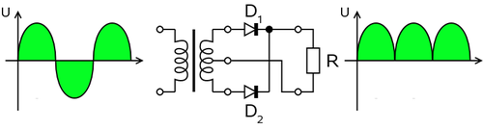
Full wave rectifier using transformer and 2 diodes

Slide 11
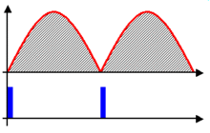
Output voltage of the full wave rectifier Animation

Slide 12
Full wave rectification
  In a circuit with a non - center tapped transformer, four diodes are required instead of the one needed for half-wave rectification.
  For single-phase AC, if the transformer is center-tapped, then two diodes back-to-back (i.e. anodes-to-anode or cathode-to-cathode) can form a full-wave rectifier.

Slide 13
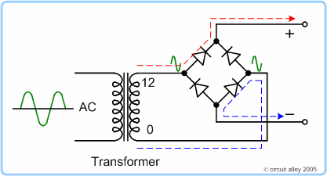
Full wave rectifier working animation

Slide 14
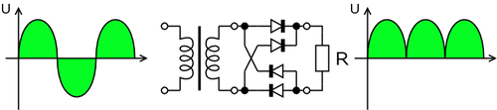
Full wave rectifier using 4 diodes

Slide 15


formula
The average and root-mean-square output voltages of an ideal single phase full wave rectifier can be calculated as:

Slide 16
Bridge rectifier
A bridge rectifier makes use of four diodes in a bridge arrangement to achieve full-wave rectification.

Slide 17
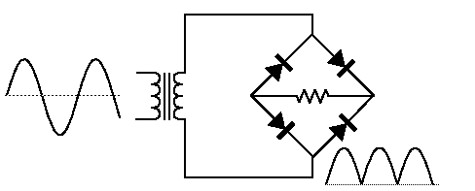
Bridge rectifier circuit

Slide 18
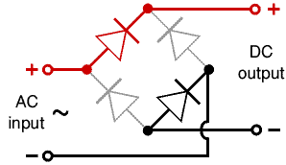
Bridge rectifier working animation

Slide 19
Clippers
A circuit which cutoff voltage above or below are both specified level is called clipper.
A clipper which removes a portion of positive half cycle of the input signal is called positive clipper.
A clipper circuit that removes the negative half cycle is called negative clipper.

Slide 20
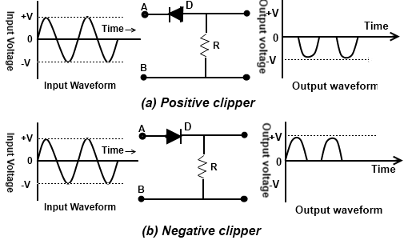
Clippers

Slide 21
Biased Clipper Circuit
If bias voltage is placed in series with diode then the circuit is called biased clipper or limiter circuit.
This bias determines the point where the diode begins to conduct and duration of conduction.
With bias, clipping can be done to any percent of the input signal ranging from 1% to 99%.

Slide 22
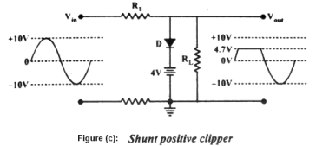
Single End Clipper

Slide 23
Single End Clipper
Figure (c) shows a single end positive clipper.
Notice that the positive terminal of the battery connected to the diodes cathode therefore diode conducts when input voltage reaches at the level of 4.7 volt (VBias + 0.7).
And when diode is conducting there will no current in RL and no voltage will drop across R . So that all the input voltage above this level will be clipped off at the output.
If the bias voltage is varied up or down the clipping level changes correspondingly.

Slide 24
Double Diode Clipper
A circuit that can be used to limit the peaks of both half cycles of an A.C. input signal is called double-end clipper.

Slide 25
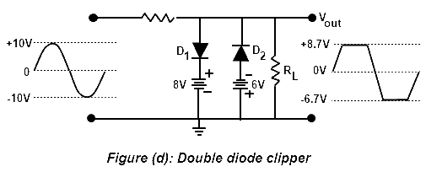
Double Diode Clipper

Slide 26
Double Diode Clipper
Notice that this circuit contains a shunt positive clipper with positive bias and shunt negative clipper with negative bias.
Notice that this circuit contains a shunt positive clipper with positive bias and shunt negative clipper with negative bias.

Slide 27
Clampers
A circuit that places either the positive or negative peak of a signal at a desired D.C level is known as clamping.
A clamping adds a D.C components to the signal and does not change the shape or amplitude of the input signal.
Clamping circuits place the negative and positive peaks of the waveform at a desired DC level.
In other words, these circuits shift the input signal by an amount defined by the independent voltage source. Today, Clamping circuits are also known popularly as Clamped-Capacitors.

Slide 28
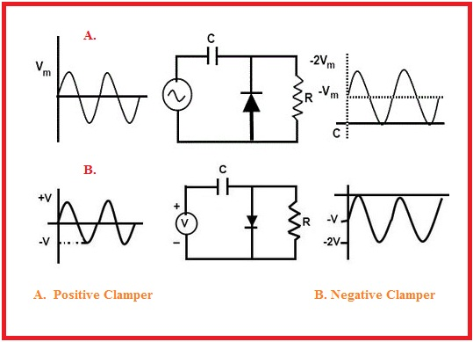
Clampers

Slide 29
Clampers
The basic idea of the clamper circuits are shown in the figure on previous slide.
Here the input signal is a sine wave having a peak to peak value of 10V.
In case of a positive clamper, it pushes the signal to upwards so that the negative peak falls on the zero level.
While in the case of the negative clamper, it pushes the signal downwards so that the positive peak of the signal falls on the zero level.
One thing can be seen that the original shape of the signal is not changed in any of the clamper outputs.

Slide 30
Clampers - Basics
In order to change the dc reference of the input signal, a clamper circuit usually uses:
  A diode,
  Load resistor and
  A capacitor for its operation.
General principle of the clamper circuit is that, the charging time of the capacitor in the clamper must be small compared to the discharging time of the capacitor in the clamper.

Slide 31
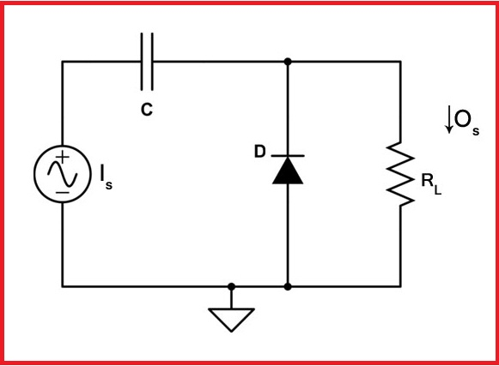
Positive Clamper

Slide 32
Positive Clamper
Figure shows the circuit of a positive clamper.
The input signal I_{s} to the circuit is a square waveform.
The output signal O_{s} will be obtained across the load resistor.
Here C represents the capacitor, D a diode, V voltage supply and R_{L} represents the load resistor.

Slide 33
Positive Clamper Operation
Proper operation of the clamper follows two points:
  Time constant z= R_{L}C must be very large.
  Time constant must be greater than the time period of the input signal.
  During Negative Half Cycle
    D is forward biased.
    D is short.
    Charging Time Constant = R_{f} C is small.
    R_{f} represents forward resistance of the diode.
    Capacitor charges to V volts.
    Voltage across R_{L} is zero.
During Positive Half Cycle
  D is reverse biased.
  D is open.
  Discharging time very large.
  Capacitor remains at V volts.

Slide 34
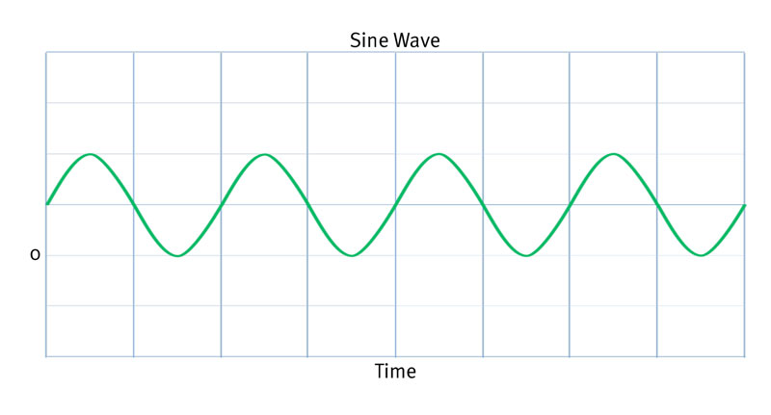
Positive Clamper Output

Slide 35
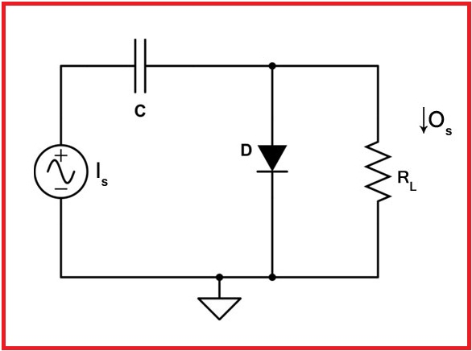
Negative Clampers

Slide 36
Negative Clamper
Figure below shows the circuit of a negative clamper.
The input signal I_{s} to the circuit is a sine waveform.
The output signal O_{s} will be obtained across the load resistor.
Here C represents the capacitor, D a diode, V voltage supply and R_{L} represents the load resistor.

Slide 37
Negative Clamper Operation
During Positive Half Cycle
  D is forward biased.
  D is short.
  Charging Time Constant z= R_{f} C is small.
  R_{f} represents forward resistance of the diode.
  Capacitor charges to V volts.
  Voltage across R_{L} is zero.
During Negative Half Cycle
  D is reverse biased.
  D is open.
  Discharging time very large.
  Capacitor remains at V volts.

Slide 38
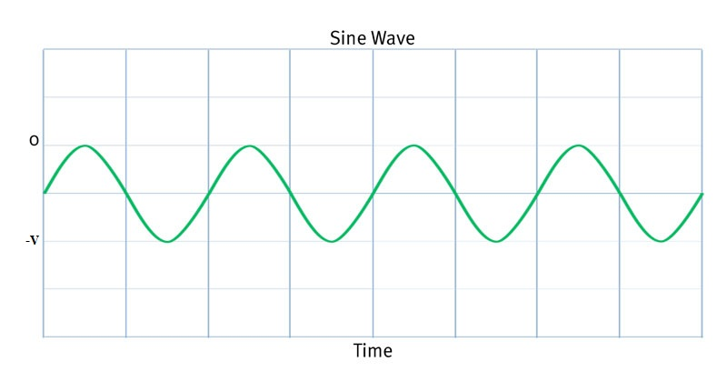
Negative Clamper Output

Slide 39
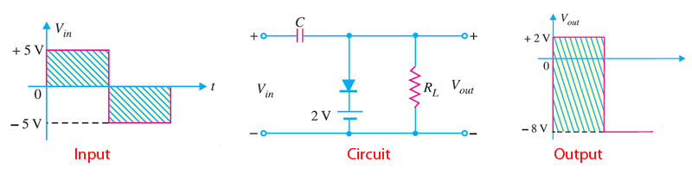
Example for Clamper Circuits
Consider the circuit shown in the figure below and find its output waveform.
  Here input voltage is 5V.
  During positive cycle:
    D is forward biased.
    D is short.
    Vout= 2V.
    Using Kirchoffs Law:
    Vin – Vc – Vout= 0
    5- Vc- 2 = 0
    Vc =3V.
The output waveform tells that the circuit given is a negative clamper and the dc reference level here is 2V.
During negative cycle:
  D is reverse biased.
  D is open.
  Using Kirchoffs Law:
  Vin-Vc-Vout = 0
  Vout= - 8V.

Slide 40
Tips and Tricks for Clamper Circuits
To identify the type of clamper circuit, just look at the diode. If the diode points in the upward direction, it is a positive clamper. While if the diode points in the downward direction, it forms a negative clamper.
Use Kirchoffs Law to find Vc and Vout.

Slide 41
Book Source: A

